Slide 1

Commercial Real Estate Historical Analysis
Mehrdad AkhLaghi,
Sargun Singh,
Rolando Jule,
Ella Pineda,
Tito K

Slide 2
Project Proposal
Our team has chosen to work on a financial analysis model, focusing on the commercial real estate market, particularly Office Buildings. Our main areas of focus will include the golden horseshoe area in Ontario. The region and cities that we will be comparing is Toronto, ON as it is a strong real estate candidate.
Our analysis will generate historical and current data comparison, so that we can have a much better understanding and to identify the growth trends within the market, and as well as which KPI (Key Performance Indicators) have substantial role in those trends. To analyze the growth in further depth, we will provide visualization on all Key Performance Indicators which constitutes the market analysis.
In addition to understand the patterns and volatility of the CRE office building market, we will directly compare the office real estate sales/investment market to Canadian annual interest rates, from 2012-2022. Thus, providing us with a correlation model, which can represent, if a direct correlation exists between the two.
Lastly, we will provide an analysis, to show weather or not there is a correlation between the quarterly interest rate, REIT stocks, property sales/investment and new development.

Slide 3
Project Proposal
As for some of the questions that we will be asking from our analysis will be:
Identify the max and min in office building sales within the last 10 years
Identify and visualize the inventory of office buildings with the following, as well as what years we saw increase and decrease in inventory:
Existing
Under construction
Construction starts
Demolitions and deliverables -Identify Vacancy rates and occupancy rates, through the ten years. Has it been consistent or not? In what years did the market experience a downturn and up turn.
Identify and visualize sales volume by location, types of transactions, types of buyers and sellers, who are the big players and what percentage of the market they occupy? Has this been consistent through out the 10 years?
Identify and calculate interest rates for the past 10 years. Is there a relationship between interest rate and sales volume? If so, provide examples within the data (annual sales, year, and the driving force)
Identify two major Canadian REITs, visualize their ten-year stock growth, to find out if there are any correlation exists between REIT stock growth and CRE market.
Identify and showcase the net absorption. Has the demand increased or decreased over the years?
Does Toronto have experience strong growth in inventory, sales volume, rental market increase, occupancy rate, new construction and under construction? What are some of the driving factors of the growth?
Identify the down turns and up turn in each market and specify the driving force for such results.
What are the property's area’s major economic drivers? Who are the major tenants or corporations? What is the average rate of return on investment (and is that trending upward or downward)?
For our project, we will obtain some of our data regarding the commercial real estate market from COSTAR.com. We will obtain our historical annual interest rate from 2012-2022 via bank of Canada.
As per the data regarding stock on REITS, we will generate a 10-year data stock history for particular REITS from reitreport.ca.

Slide 4
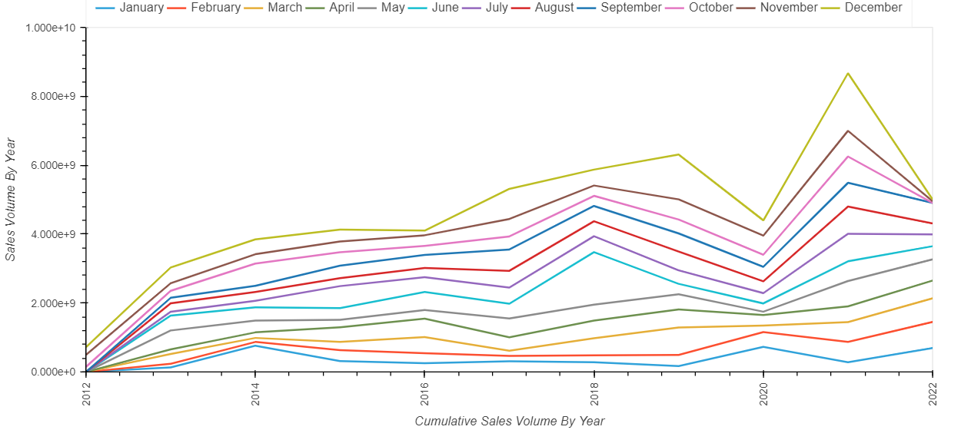
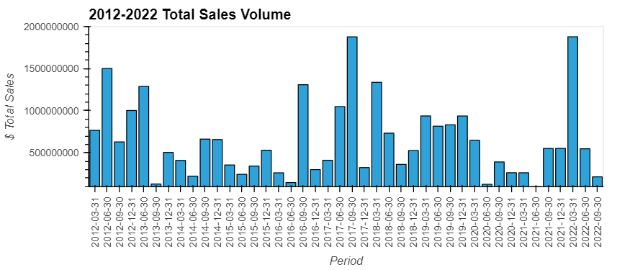
COMMERCIAL REAL ESTATE SALES ANALYSIS (OFFICE)
Sales volume by year 2012-2022
Vs
Total Sales volume by quarterly 2012-2022

Slide 5
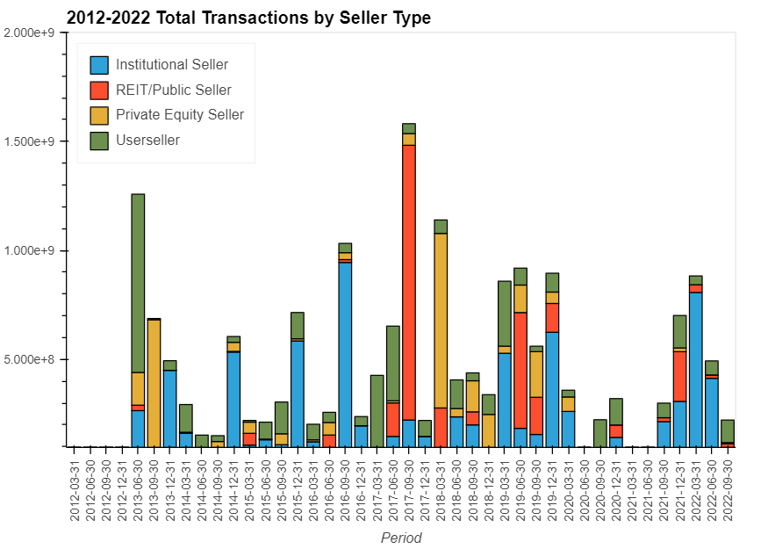
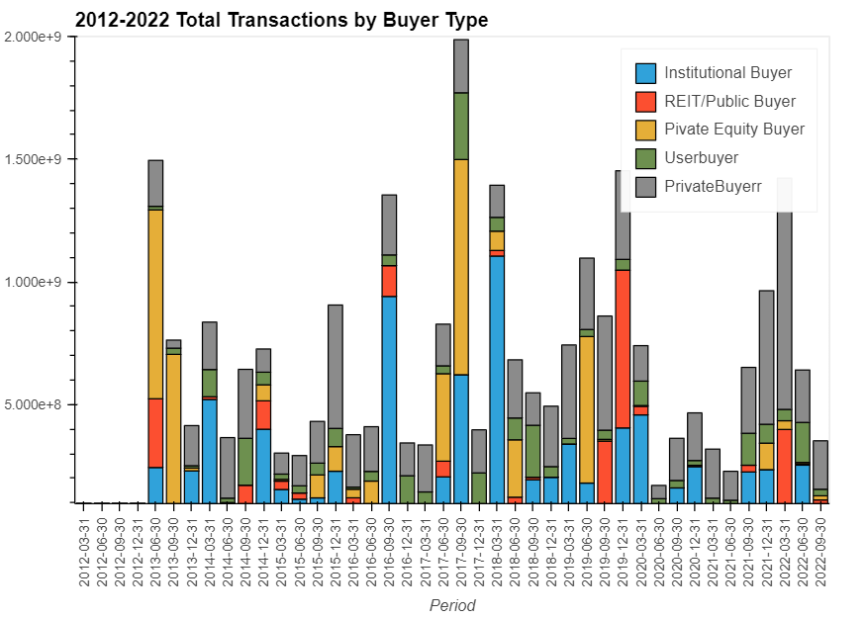
TOTAL TRANSACTION BY TYPES OF BUYERS AND SELLERS
Institutional Buyer : $ 1,105,119,505
REIT/Public Buyer : $ 643,341,793
Private Equity Buyer : $ 876,963,293
Private Buyer: $ 94,469,553
User Buyer : $ 271,923,964
Institutional Seller : $ 9,424,549,672
REIT/Public Seller : $ 1,260,550,568
Private Equity Seller : $ 800,657,500
Private Seller: $ 91,479,816
User Buyer Seller: $ 817,632,598

Slide 6
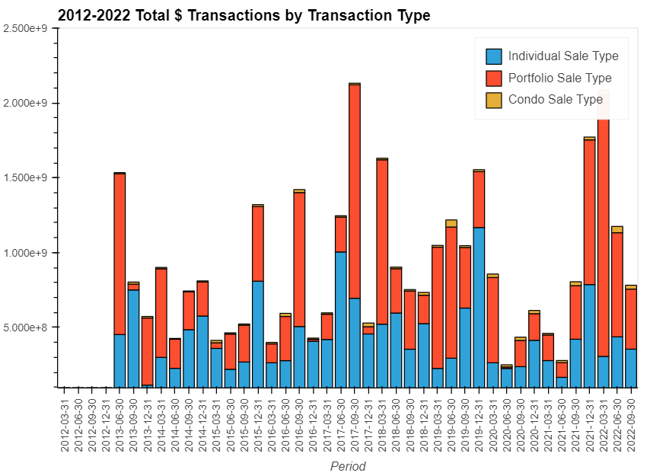
TOTAL TRANSACTIONS BY TRANSACTION TYPE
INDIVIDUAL : $ 1,167,454,792
PORTFOLIO : $ 1,747,278,825
CONDO : $ 47,411,748

Slide 7
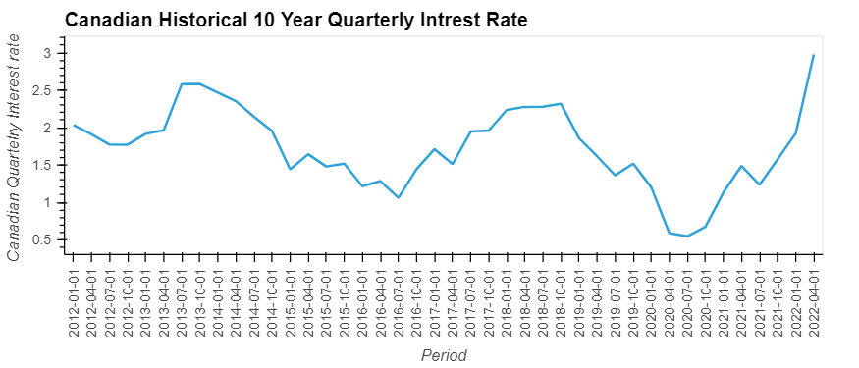
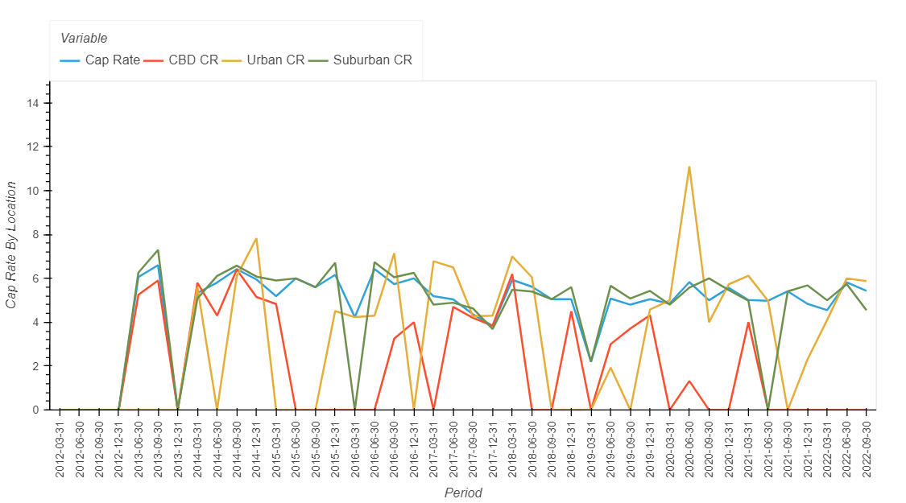
CAP RATE VS INTEREST RATE HISTORICAL QUARTERLY
Seeing the trend between both interest rate and cap rate, it is evident that there is a coloration between the two, as similar lows and highs can be seen in both graphs.

Slide 8
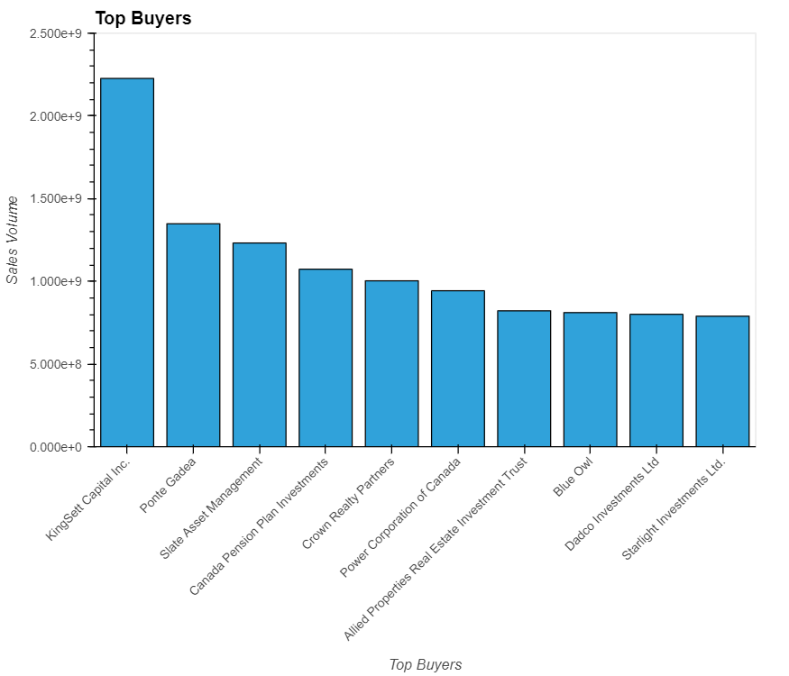
TOP BUYERS
 | Sales Volume
Top Buyers
KingSett Capital Inc. | $2,226,803,633
Ponte Gadea | $1,347,996,838
Slate Asset Management | $1,231,803,018
Canada Pension Plan Investments | $1,073,292,907
Crown Realty Partners | $1,003,094,846
Power Corporation of Canada | $943,085,930
Allied Properties Real Estate Investment Trust | $821,663,343
Blue Owl | $810,908,292
Dadco Investments Ltd | $800,657,500
Starlight Investments Ltd. | $789,100,001

Slide 9
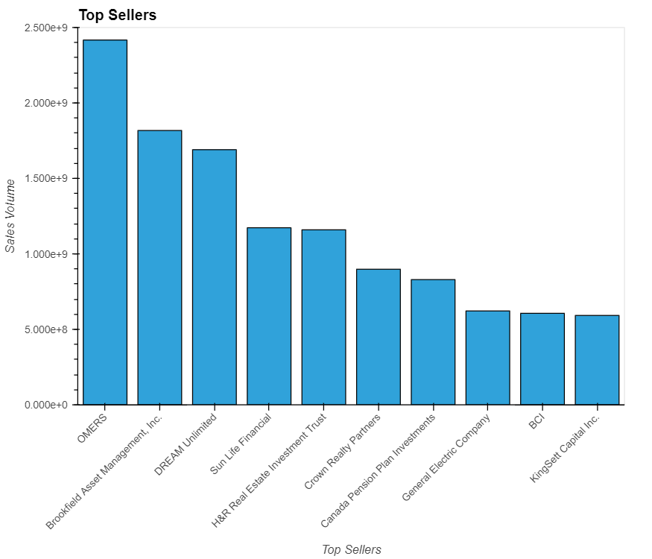
TOP SELLERS
 | Sales Volume
Top Sellers
OMERS | $2,416,795,484
Brookfield Asset Management, Inc. | $1,817,554,196
DREAM Unlimited | $1,690,456,629
Sun Life Financial | $1,173,186,928
H&R Real Estate Investment Trust | $1,159,531,638
Crown Realty Partners | $898,240,603
Canada Pension Plan Investments | $829,651,016
General Electric Company | $621,950,018
BCI | $606,238,250
KingSett Capital Inc. | $592,163,241

Slide 10
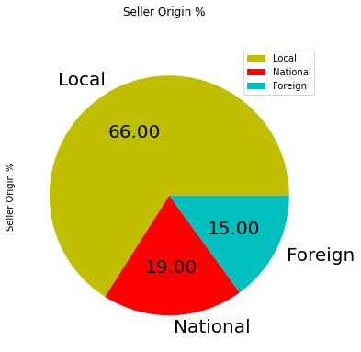
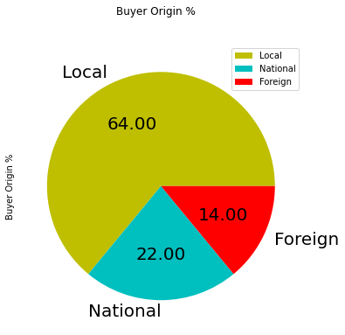
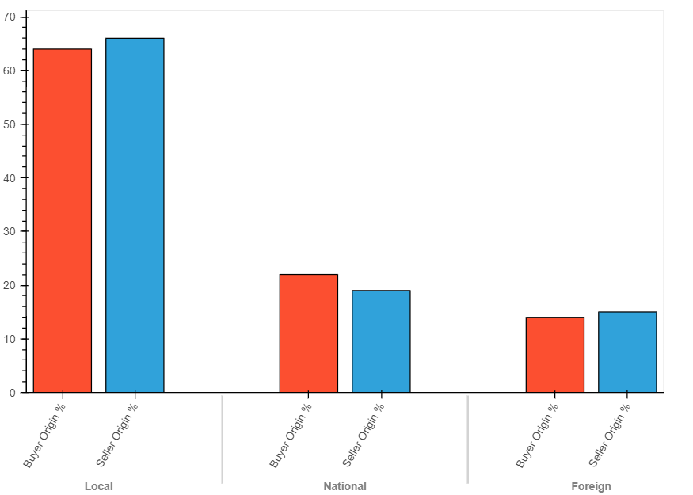
BUYER VS SELLER ORIGIN
On the seller as well as buyer side it is evident that the local buyers makeup the largest portion of the market. This trend has been consistent within the last 10 years.

Slide 11
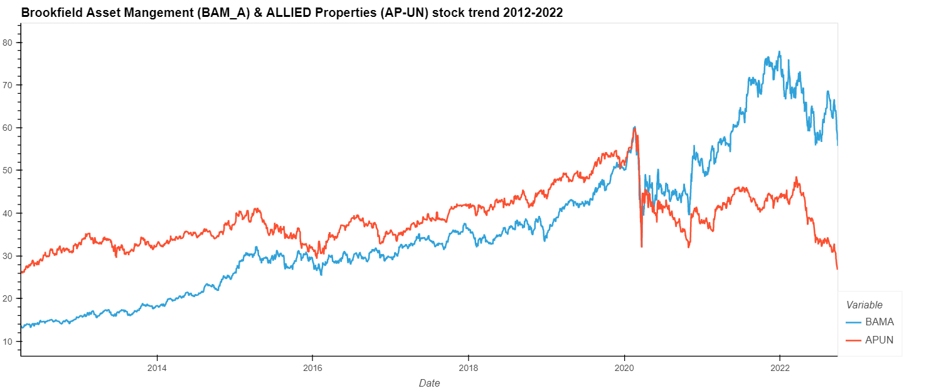
REIT STOCKS VS INTEREST RATE AND SALES VOLUME
In this model we can see the relation of the sales volume with both interest rate and as well as the overall health of the REIT stock. Brookfield Asset management and Allied Properties stocks move very much in relation with the interest rate. As interest rats go higher, there are visible dips in value of the stock and as well the annual sales volume of the REIT’s. For example in year April 2013 as interest rate increased, there was reverse effect on the sales volume and stock values. The opposite can be seen in the first 3 quarters as the interest rate drops, the stock value increases as well as the sales volume.

Slide 12
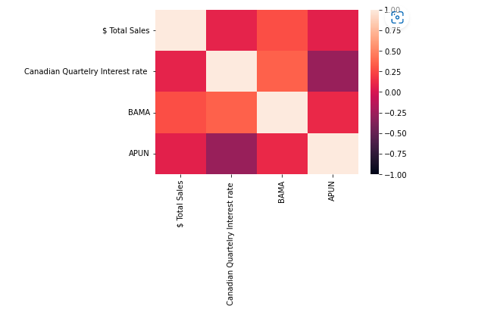
Correlation Matrix
Total Sales Volume
Canadian Quarterly Interest Rates
BAM-A.TO
AP-UN.TO

Slide 13
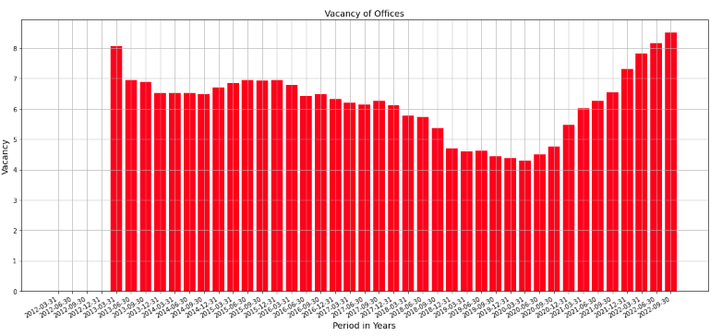
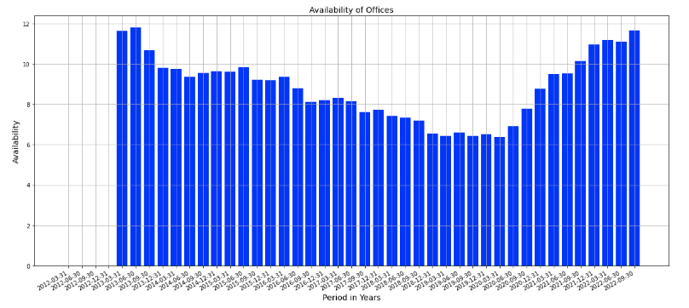
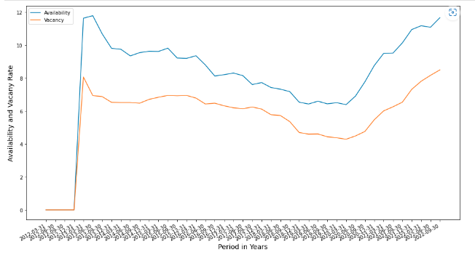
Availability and Vacancy

Slide 14
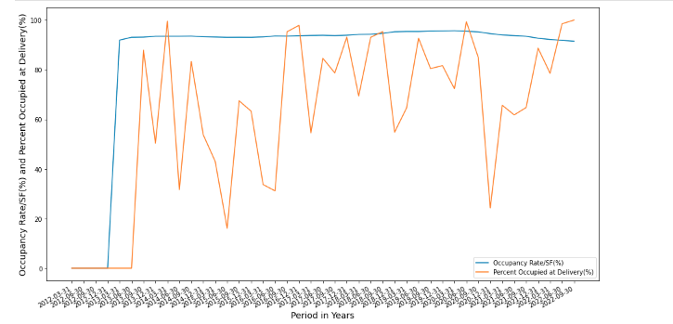
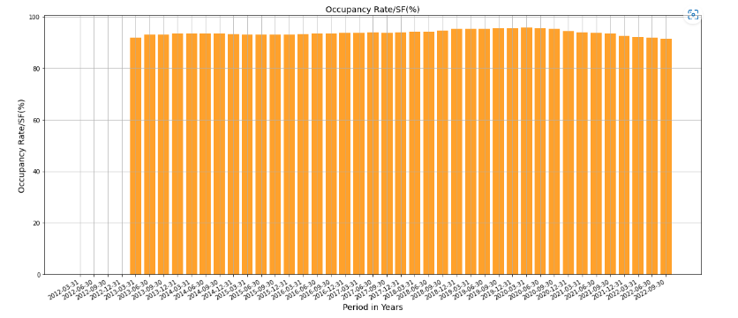
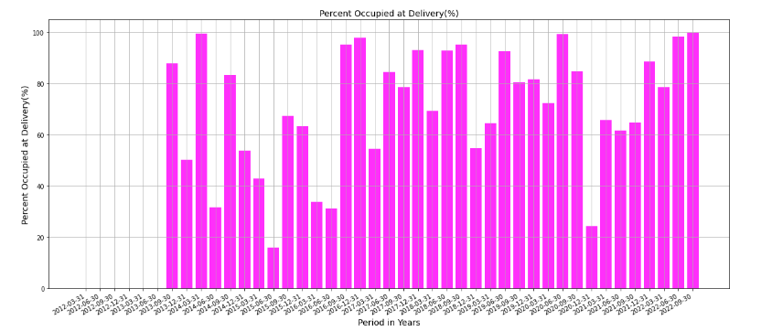
OCCUPANCY AT DELIVERY AND OVERALL OCCUPANCY RATE

Slide 15
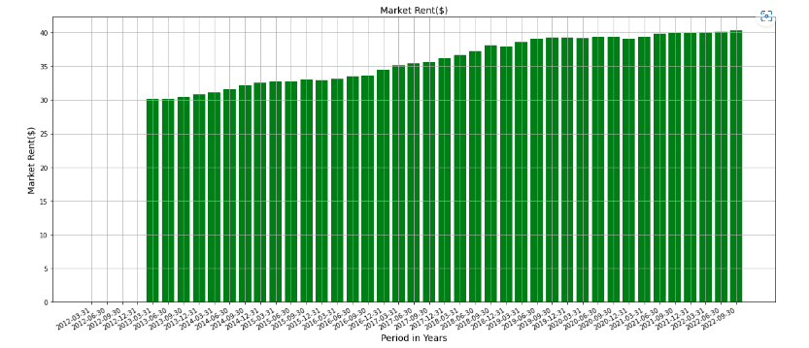
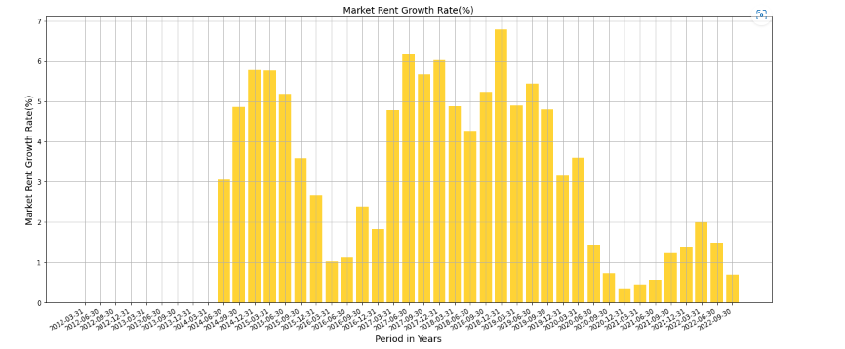
MARKET RENT ($) AND MARKET RENT GROWTH RATE (%)

Slide 16
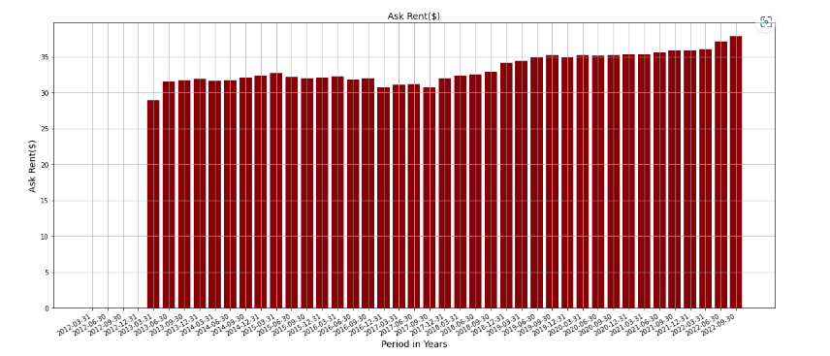
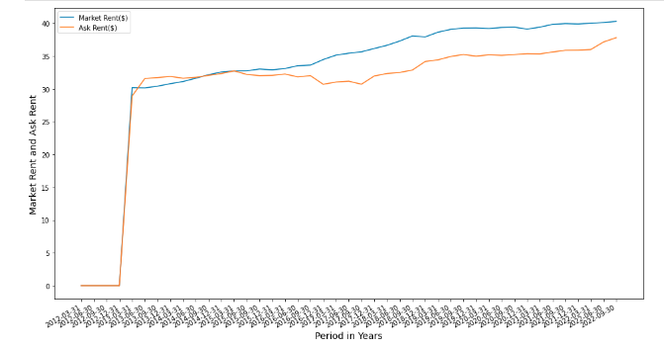
MARKET RENT ($) AND ASK RENT ($)

Slide 17
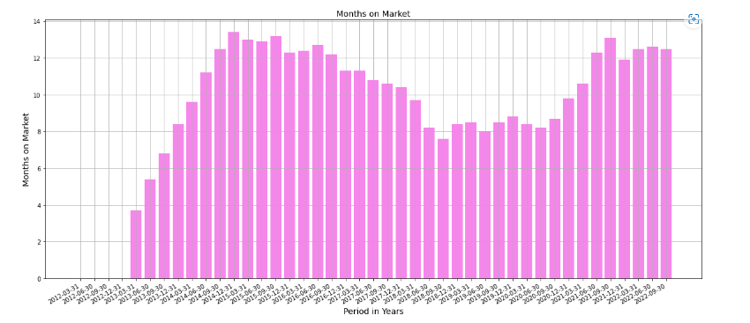
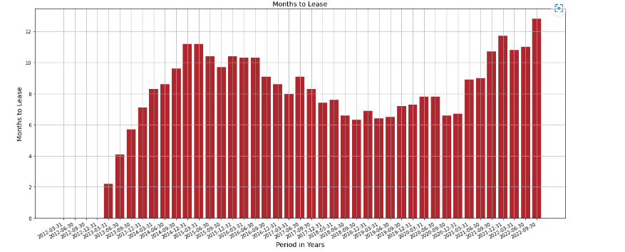
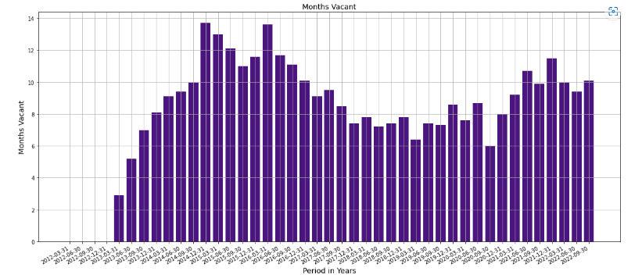
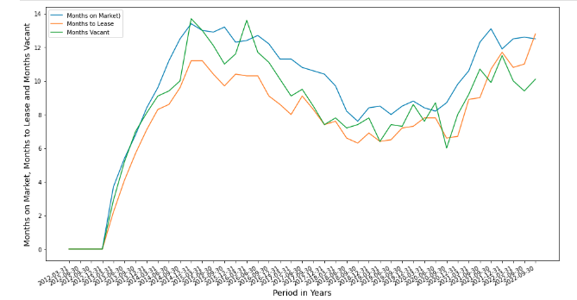
MONTHS ON MARKET VS MONTHS TO LEASE VS MONTHS VACANT

Slide 18
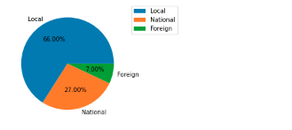
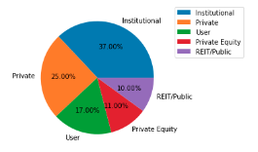
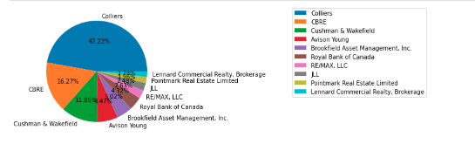

Slide 19
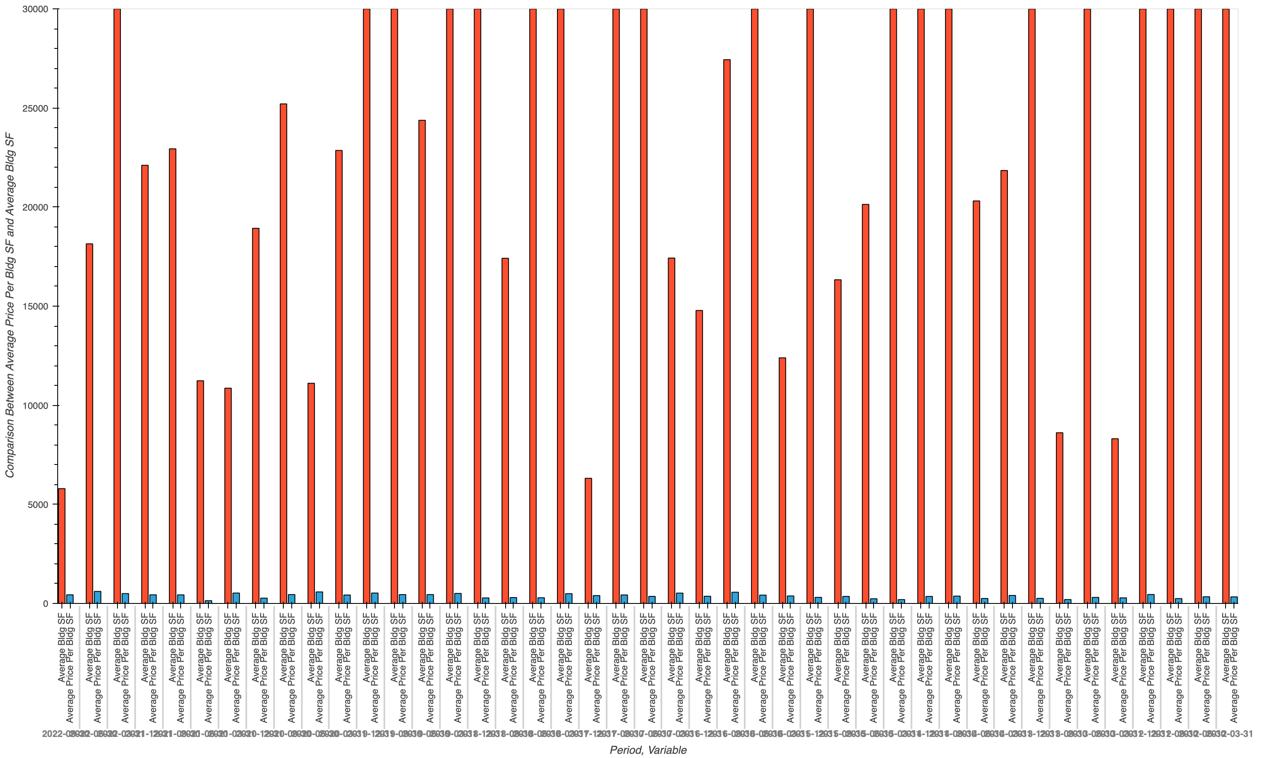
COMPARISON BETWEEN AVERAGE SALE PRICE AND AVERAGE BLDG SF
As you can see in the bar chat the Average Building SF is much larger than the price. An interesting observation I made was that even though a building might have a lot of square footage that isn’t the only thing that justifies the average sale price. For example, if you take a look at June 30th 2012, a building with an average building SF of 105959 is being sold for and average price of $337.17. In comparison the most expensive sale was $608.31 and it was for a building with an average building sf of 18144.

Slide 20
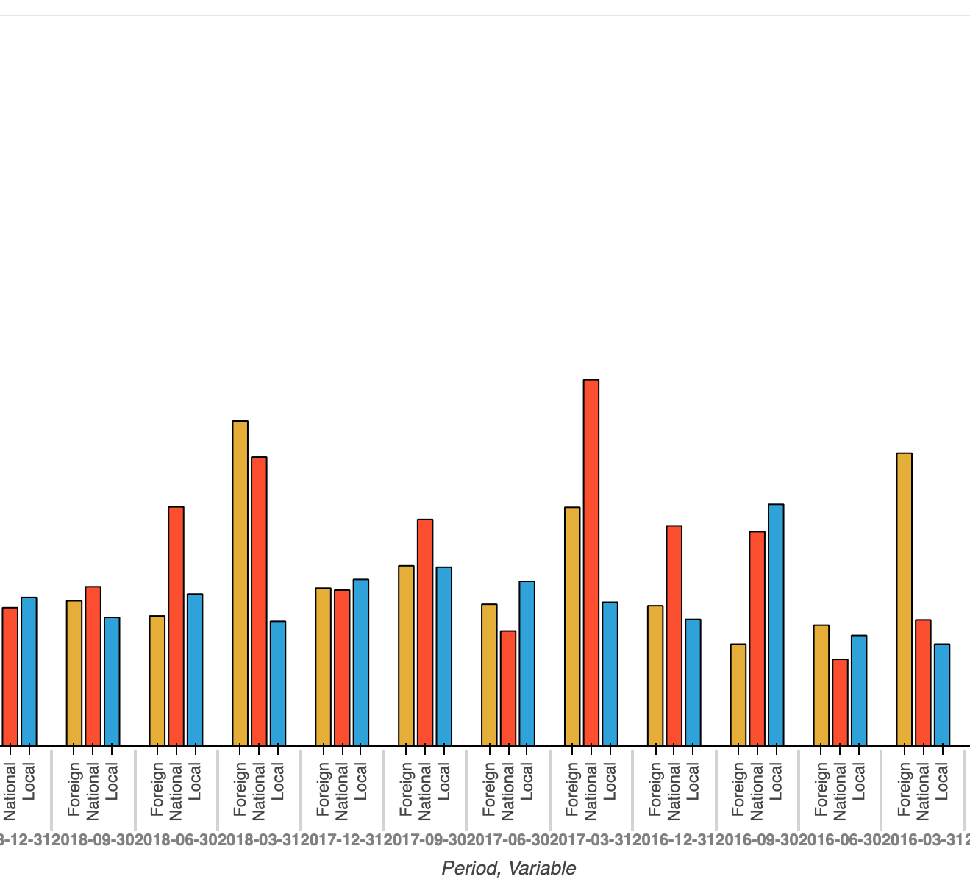
COMPARISON BETWEEN LOCAL, NATIONAL, AND FOREIGN CAPITAL INJECTION
In this bar chart we are looking at the comparison between local, national, and foreign capital investment from the bar chat I can see that out of all the other options the most capital injection came from national parties. This means that most of the land sf in Toronto is getting an injection of capital from companies all over the country. In second was Foreign injection. Foreign injection means that the capital being put into the property isn’t from this country. Lastly we had local injection.

Slide 21
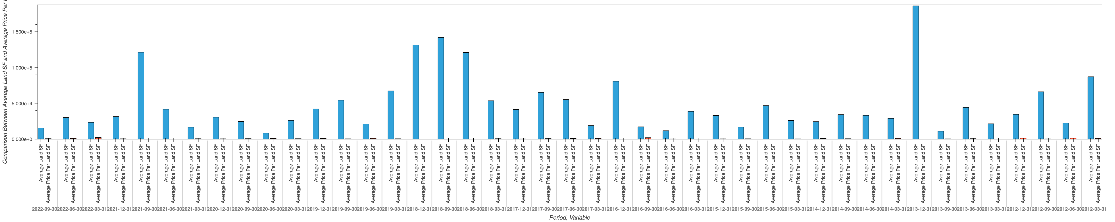
COMPARISON BETWEEN AVERAGE LAND SF AND AVERAGE PRICE PER LAND SF
In this bar chart we are looking at the comparison, between Average Land SF and Average Price Per Land SF. When looking at the graph you can see that the even though building have large amounts of square footage the price is still quite low. This means that other factors besides the square footage of the property can affect the price of a property.

Slide 22
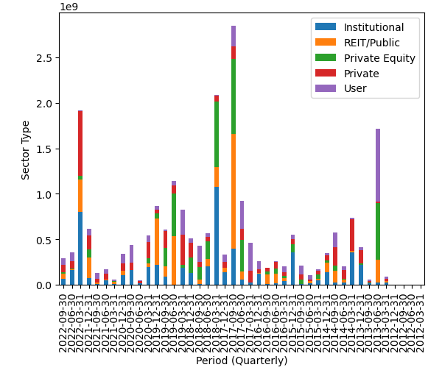

Slide 23
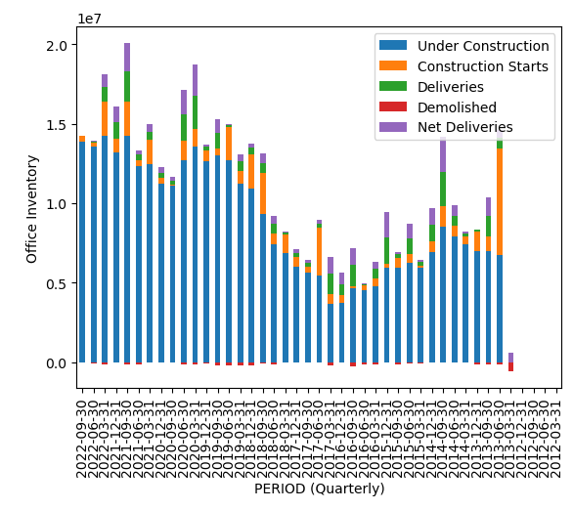

Slide 24
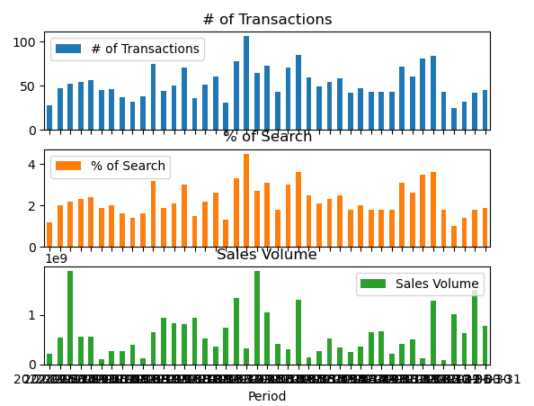

Slide 25
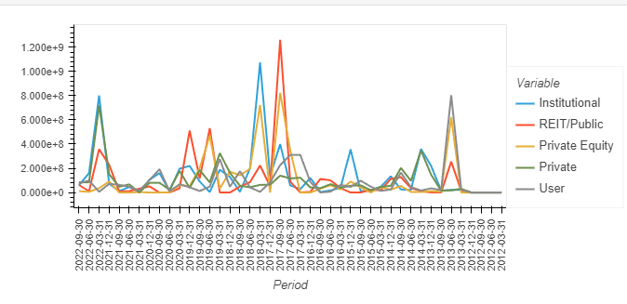

Slide 26
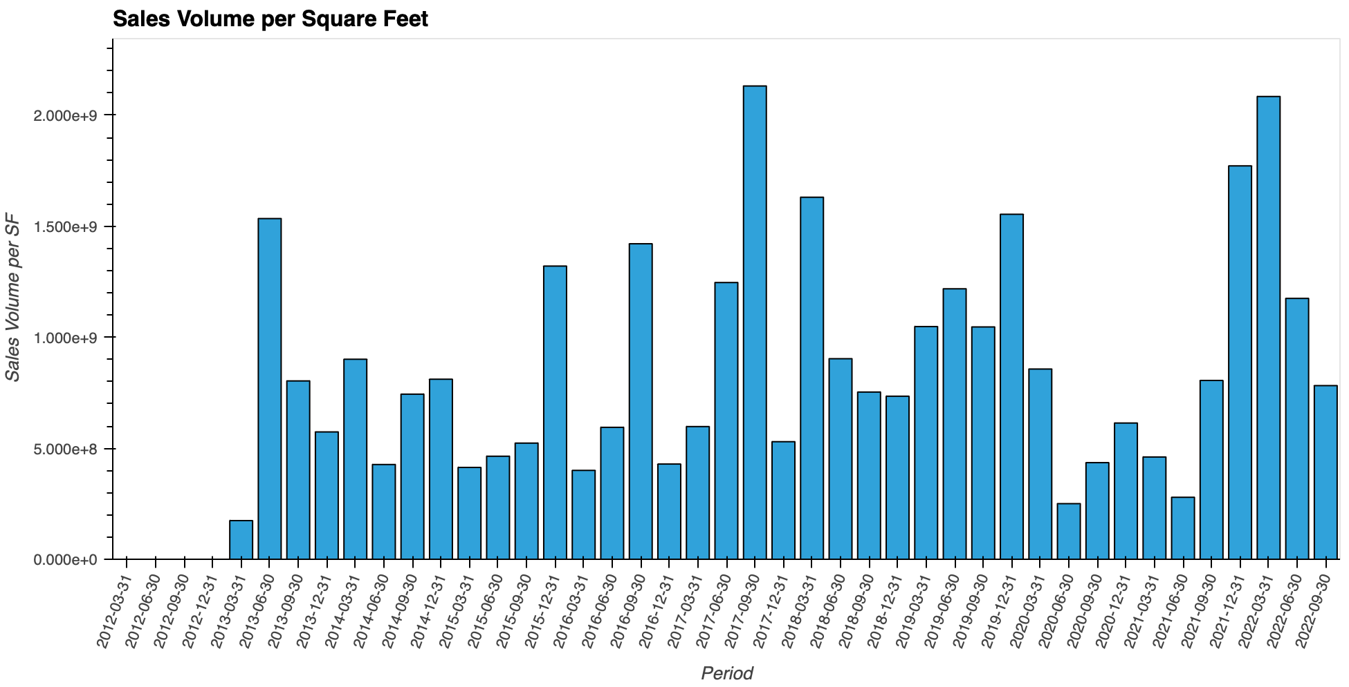
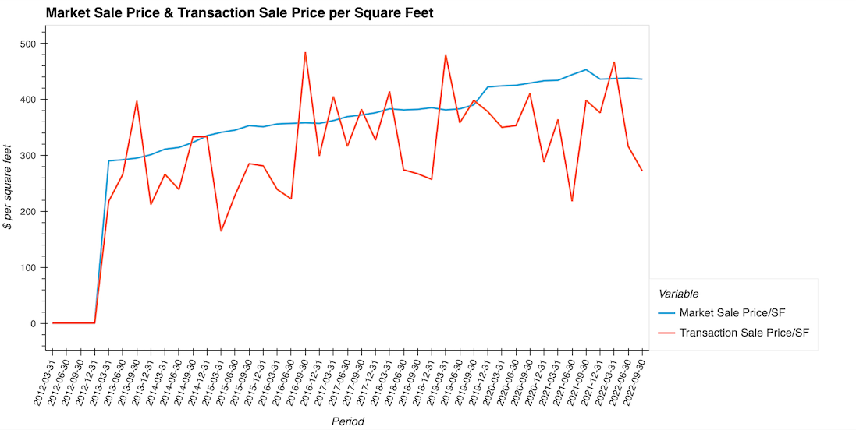

Slide 27
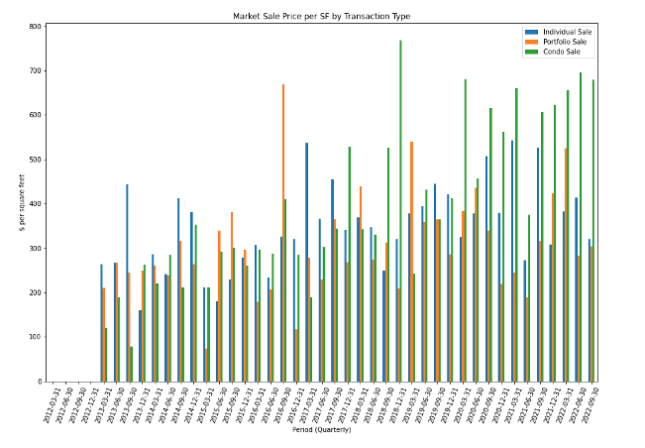

Slide 28
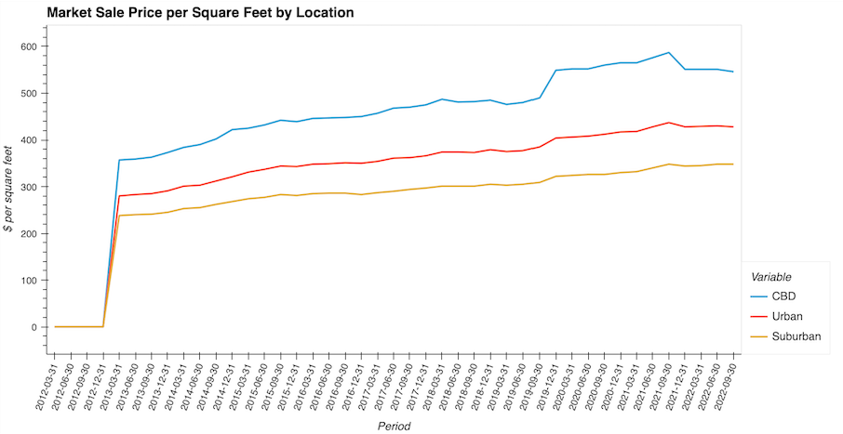

Slide 29

Questions
Thank you

